Slide 1
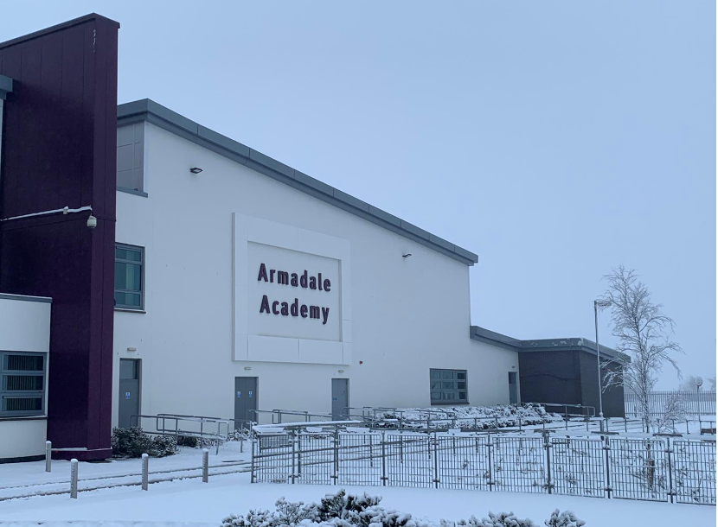
Armadale Academy
P7 Parents –TRANSITION information evening
Wednesday 1st November 2023
Learning Together, Achieving Together

Slide 2
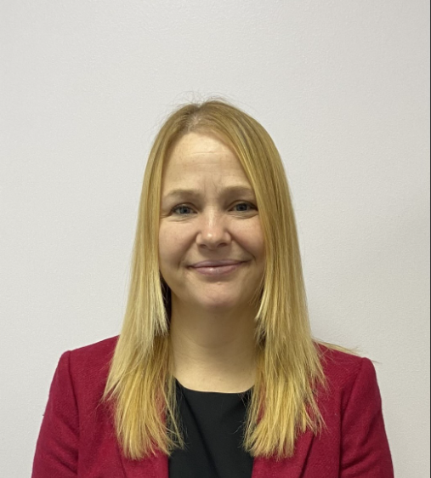
Head Teacher, Armadale Academy
Mrs Barker Harrison

Slide 3
Programme
Welcome , Mrs Barker Harrison, Head Teacher
Student Support, Mrs McGee,
Transition, Mrs Gordon
Role of Pastoral Support, Mr Gibson
Feedback Mrs Landos Mackay
Additional Support Needs, Mrs Dewar
Q&A

Slide 4
STUDENT SUPPORT AT ARMADALE ACADEMY
Mrs McGee
Depute Head Teacher (Acting)
Student Support – Equity & Inclusion
S1 & S2 Year Head
Mrs Gordon
PTC Head of House
Cochran
Mrs Landos-Mackay
PT Head of House
Honeyman
Mr Gibson
PT Head of House
Wood
Mrs Dewar
PT Support for Learning
Miss Stevenson
Teacher of Wellbeing
Cochran
Miss Rafferty
Teacher of Wellbeing
Honeyman
Mrs Thomson
Teacher of Wellbeing
Wood
Mrs Gray & Ms Carr
Support for Learning Teacher
Mrs Hill
Small Group Setting Teacher
Mrs Fraser
Student Support Manager
Notes:
Welcome to Armadale Academy.
Jen McGee – Acting DHT with responsibility for Student Support, Year Head for S1 and S2
Although Acting position, I have worked in Armadale Academy for over 11 years and know the school and community well. I am doing Mr Speedie’s job whilst he is on secondment to the council.
I am going to talk through what Student Support at Armadale Academy looks like.
House Structure – we have three houses Cochran, Honeyman and Wood – names associated with Armadale.
Each House has a Head of House, Teacher of Wellbeing a PSW and roughly has a third of the school on their caseload from S1 – S6
We have had a lot of change in the last 12 months with Maternity Covers and two of our Heads
Acting Posts
Introduce the Team….
Mr Gibson will speak about the roles of the Team later in the presentation.
In addition to this we have Mrs Dewar our Principal Teacher for Support for Learning who works with two SfL Teachers and we also a teacher in our Small Group Setting.
Mrs Fraser is not here this evening but she is our Student Support Manager who works in our Inclusion & Employability Hub and mainly works with students with social, emotional and behaviour needs.
In addition to that we have Rebekah Scott our Family Link Worker who works with students and their families around support positive attendance at school.
We know that many of our families are familiar with the school and we have a lot of former pupils who’s children come to Armadale Academy and may be familiar with the House Names.

Slide 5
Student Support Vision
Armadale Academy is committed to providing the highest possible levels of support and service to our all our students and families. We achieve this through building strong and effective partnerships with Parents/ Carers and Partner organisations. Our partnerships are based on shared values of ambition, positive attitude, achievement, community, equity and respect.
Our key priorities in Student Support are providing support to improve:
Attendance
Attainment
Health and Wellbeing
Positive destinations
Notes:
This is the vision of Student Support in Armadale Academy.
We are the Key Adults in the school for our students.
We want to work with you through the six years your child will be with us.
Everything we aim to do is based on our school balues.

Slide 6
Wellbeing Indicators
Notes:
You might be familiar from GIRFEC from Primary School – Getting it right for every child is the framework to provide all children, young people and their families with the right support at the right time. This is so that every child and young person in Scotland can reach their full potential.
Our aim is to have successful learners, confident individuals, effective contributors and responsible citizens who are safe, healthy, achieving, nurtured, active, respected, responsible and included.

Slide 7
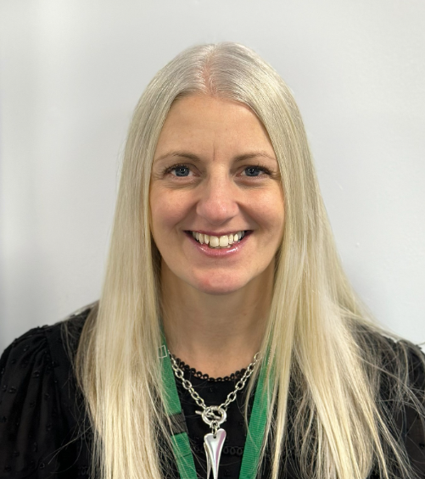
TRANSITIONS
Mrs Gordon
PTC Student Support and Transitions
Head of Cochran House

Slide 8
Transition Aim
Keep you informed of what is happening and why
Listen to you and your child to ensure your wishes have been heard and understood.
Involve you in decisions as appropriate
Respond timeously to enquiries.

Slide 9
Partnership
Head Teacher meets regularly with primary heads.
DHT Student Support meets regularly with primary heads
PTC Additional Support Needs & Student Support Manager are involved in High Level Transition
Planning for Maths teachers visit schools and take classes
Planning for French/English visit schools for Literacy input
PTCs work together on standards across the curriculum.
Senior Students’ visits to Primary Schools
DHT and HOH will carry out class visits nearer 3 day visit
Class lists quality assured by P7 class teachers

Slide 10
Transition Form
Academic level
ASN needs
Interests
Siblings and Step Siblings
Avoids
Create Class Lists

Slide 11
Class Setting
The factors we consider are as follows:
Providing best possible learning experience for our students
Balance of male/female divide within a class
Balance of students coming from different Primary Schools within a class
HOUSE alignment - if siblings attend/attended school
Number of students requiring additional support with their learning in one class

Slide 12
PARENT/CARER INFORMATION EVENING
PARENT/CARER INFORMATION EVENING
FOCUS | DATE | TIME | LOCATION
Student Support and Transition | Wednesday 1st November, 2023 | 6pm – 7pm | Armadale Academy
Learning, Teaching and Curriculum | Thursday 22nd February | 6pm – 7pm | Armadale Academy
Uniform Evening | 19th June | 6pm – 7pm | Armadale Academy

Slide 13
HALF DAY VISITS
HALF DAY VISITS
PRIMARY SCHOOL | DATE | START TIME | FINISH TIME
Blackridge/ Southdale | Friday, 10th November | 9.30 am | 12 pm
Eastertoun Primary School | Friday 17th November | 9.30 am | 12 pm
Windyknowe Primary School | Friday 24th November | 9.30 am | 11.30 pm
Armadale Primary | Friday 1st December | 9.30 am | 12 pm

Slide 14
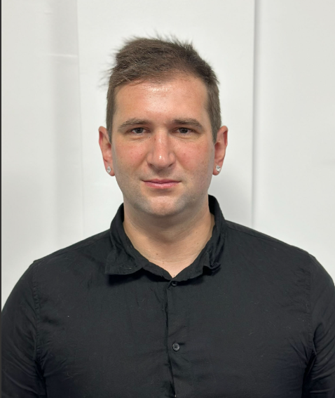
Role of Pastoral Support
Mr Gibson
PT Student Support (Acting)
Head of Wood House

Slide 15
Role of Pastoral Support at Armadale Academy
Monitor attendance
First aid and medical care
Uniform
Mediation
Group and 1:1 support on a variety of issues
Referrals for interventions such as Head Strong, Personal Best, Young Carers to name a few

Slide 16
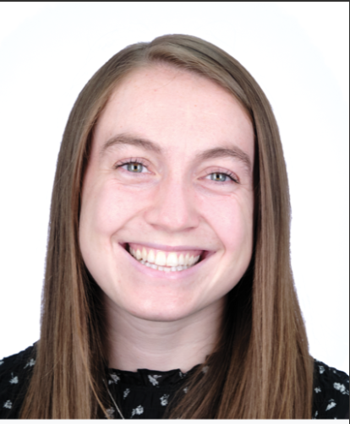
Support for Learrning
Mrs Dewar
PTC Support for Learning

Slide 17
Role of Support for Learning Department
To identify and assess additional support needs and make provision to meet them.
Plan strategies to help the young person to overcome these barriers to learning.
Involve external agencies if necessary.
Ensure that the young person achieves their potential and is an independent learner.

Slide 18
Type of Support
In class support.​
Small group teaching.
ICT for use in class e.g. Netbooks, digital exam papers.​
Developing materials and resources with subject teachers.​
Nurture Group, when appropriate.
Accelerated Reading – within English Department
Numeracy Group, Maths Recovery – within Maths Department
ASD Group
S1 Group
Achievement Classrooms
Family Link Worker
Head Strong
Interventions – Outdoor Learning, Art Therapy
Mark Brown – The Best of You

Slide 19
Our Context
Student Support
Support for Learning
Small Group Setting
Inclusion & Employability Hub
Wellbeing Interventions
Positive Transitions & Partnerships
Family Link Worker - Attendance

Slide 20
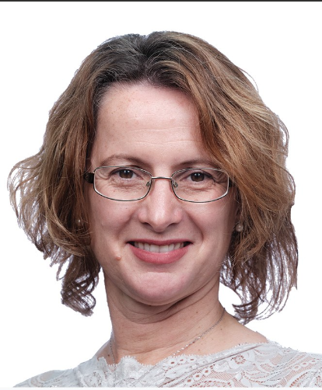
Transition Feedback
Mrs Landos Mackay
PT Student Support (Acting)
Head of Honeyman House

Slide 21
Transition Student Feedback 2022-23
During the 3 day visit, almost all students felt that Armadale Academy was welcoming and that you belonged here with us
Almost all students felt that the 3 day Transition visit helped them feel less anxious/worried about starting High School
Almost all students felt that they were treated fairly and with respect by staff
Almost all student reported that they were treated fairly and with respect by their S6 Buddies

Slide 22
Transition Parent/Carer Feedback 2022-23
Almost all parents/carers reported that their child enjoyed the 3 day visit to Armadale Academy
Almost all parents/carers reported that their child enjoyed meeting new students from other schools
Almost all parents/carers reported that their child found the S6 buddies useful in helping them to class and supporting them whilst here
Almost all parents/carers reported that they felt that we supported their child during transition, so that both their learning, social and emotional needs were addressed

Slide 23
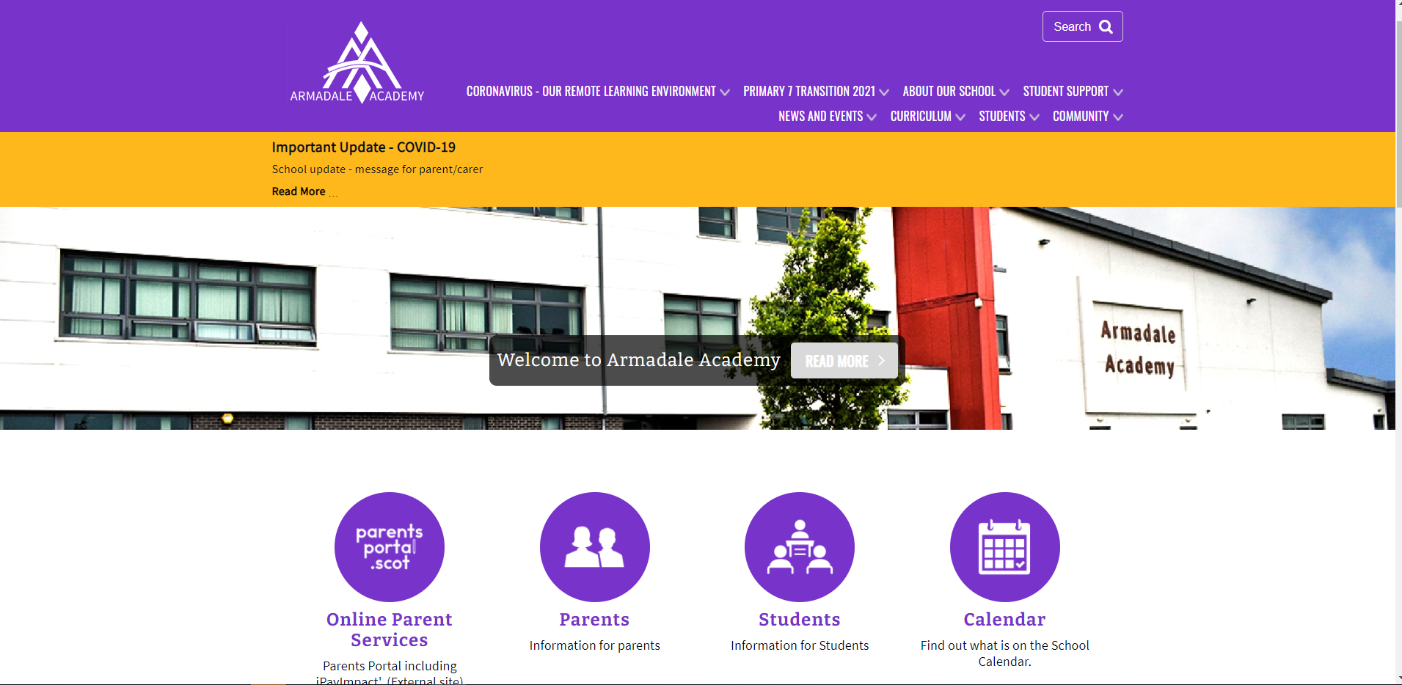
Keep in Touch – Reminder
Armadale Academy
www.armadaleacademy.co.uk
@armadaleacademy
@armadale_academy

